Slide 1
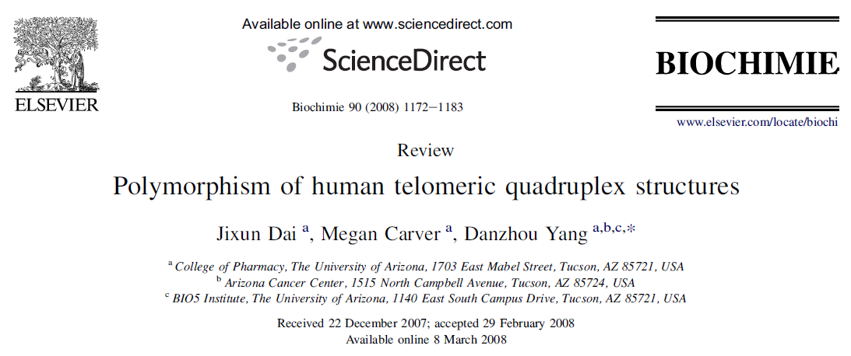
In the name of GOD
Zeinab Mokhtari
12-Oct-2011

Slide 2
Arizona University
Danzhou Yang

Slide 3
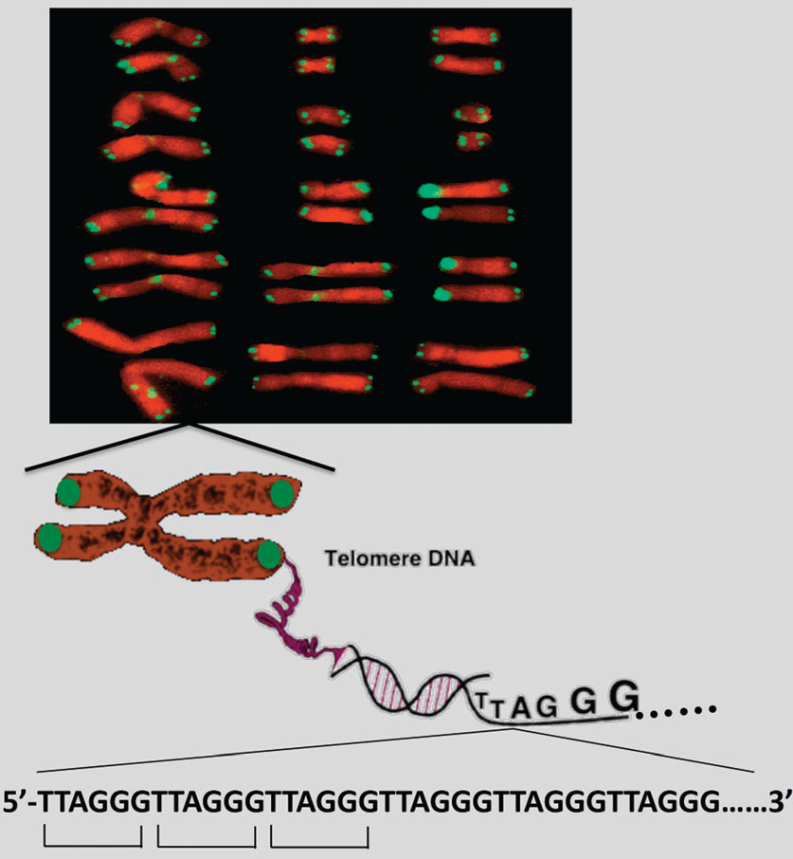
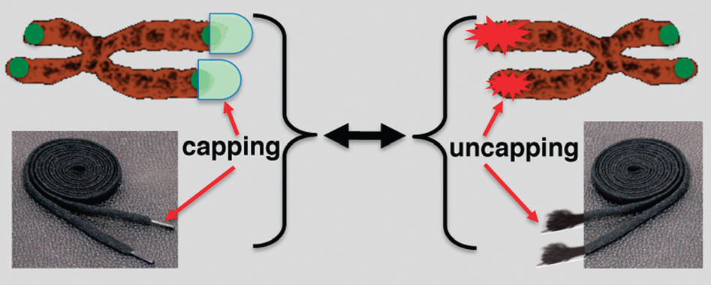
Telomeres are specialized DNA sequences that cap the ends of linear chromosomes and provide protection against gene erosion at cell divisions, chromosomal non-homologous end-joinings and nuclease attacks.
aging
cancer
genetic stability
a single-stranded 30-overhang of 100–200 bases
11_chemsocrev_telomere_review

Slide 4
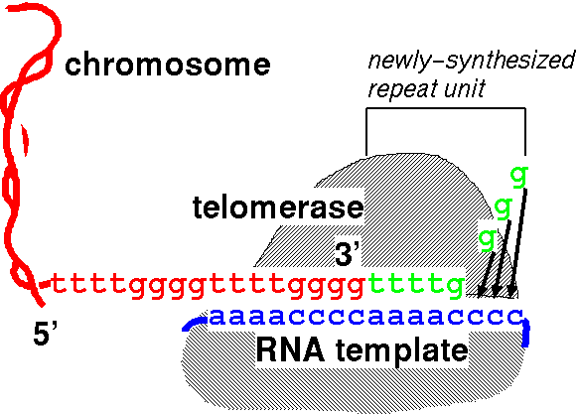
malignant phenotype
apoptosis
telomeres of cancer cells
due to the activation of a reverse transcriptase, telomerase, that extends the telomeric sequence at the chromosome ends

Slide 5
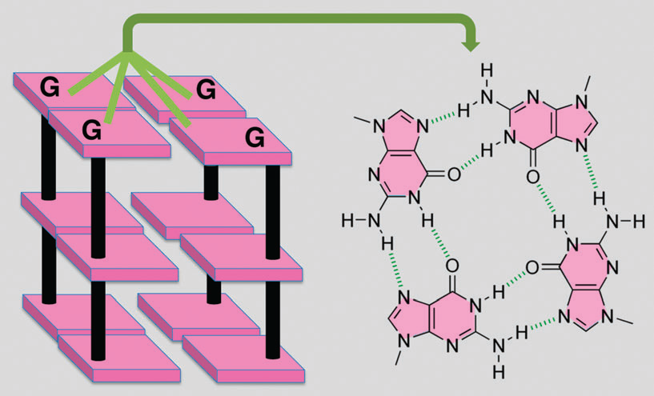
G-quadruplex DNA secondary structures that consist of stacked G-tetrad planes connected by a network of Hoogsteen hydrogen bonds and stabilized by monovalent cations.
inhibits the activity of telomerase
11_chemsocrev_telomere_review

Slide 6
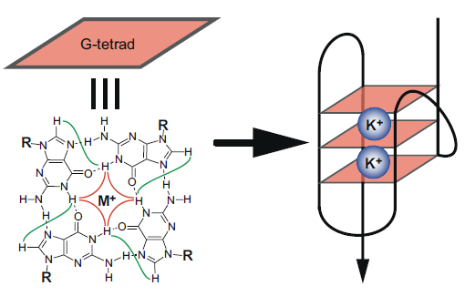
K⁺‏ structure is considered to be biologically more relevant due to the higher intracellular concentration of K⁺‏
structure-based rational drug design

Slide 7
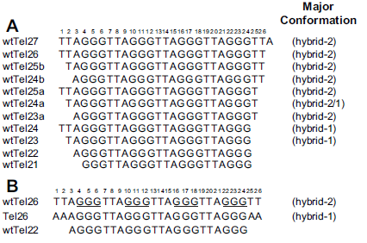
four G-tract human telomeric sequence 5’-GGG(TTAGGG)3
Minimume

Slide 8
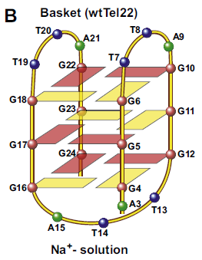
1993: 22-nt human telomeric sequence, in the presence of Na‏+

Slide 9
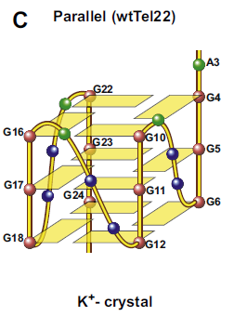
2002: a crystal structure of the parallel-stranded G-quadruplex, 22-nt human telomeric sequence, in the presence of K‏+.

Slide 10
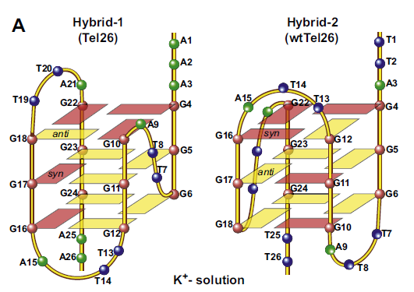
predominant conformations formed in human telomeric sequences in K+‏ solution
HYBRID 1
Mixed par (3) & antipar(1- 3rd)
Side-lateral-lateral
5 syn Gs
Top end cap: A triple
Bottom end cap: A:T base pair
HYBRID 1 & 2 diff.s :
Loop arrangements
Strands orientations
G-tetrad arrangements
Capping structures
HYBRID 2
Mixed par (3) & antipar(1- 2nd)
lateral-lateral-side
5 syn Gs
Bottom end cap: T:A:T triple

Slide 11
sequences with a 3’-flanking
wtTel27
wtTel26
wtTel25b
wtTel24b
wtTel25a
sequences with no 3’-flanking segment
wtTel23
wtTel24
dynamic equilibrium
The 3’-flanking-T(T25) is necessary for the formation of the T:A:T triple capping structure, which selectively stabilizes the hybrid-2 type telomeric G-quadruplex.

Slide 12
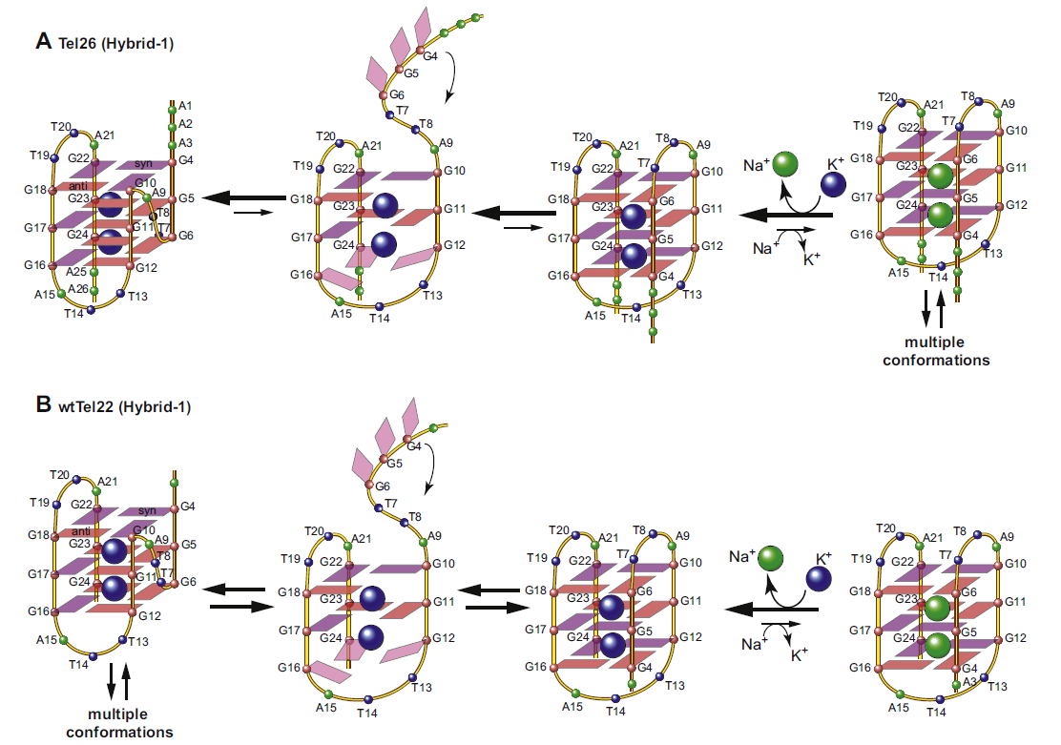
Addition of K‏⁺ readily converts the Na‏-form conformation to the K‏-form hybrid-type structures.
Hybrid-type structures are the predominant conformations for wtTel26 and Tel26 in K‏ solution, even in the co-presence of a high concentration of Na‏

Slide 13
Thanks

