Slide 2
Replacement Method and Enhanced Replacement Method Versus the Genetic Algorithm Approach for the Selection of Molecular Descriptors in QSPR/QSAR Theories
Andrew G. Mercader, Pablo R. Duchowicz, Francisco M. Ferna´ndez, and Eduardo A. Castro
J. Chem. Inf. Model. 2010, 50, 1542–1548
By:
Atefeh Malek.khatabi

Slide 3
Introduction:
These methods avoid the impracticable full search for optimal variables in large
sets of molecular descriptors.
A full search (FS) of the optimal variables is impractical because it requires
D!/(D - d)!d! linear regressions.
If D=140 , d=7 1.8*10^11
Present results for 10 different experimental databases

Slide 4
Replacement Method
RM is a rapidly convergent iterative algorithm that produces linear regression models with small S in remarkably short computer times.
For first time Pablo R. Duchowicz and et al use this method in 2005.
Step 1: We choose an initial set of descriptors dk at random, replace one of the descriptors, say Xki, with all the remaining D - d descriptors, one by one, and keep the set with the smallest value of S.
Pablo R. Duchowicz a, Eduardo A. Castro a, Francisco M. Ferna´ndez a, Maykel P. Gonzalez, Chemical Physics Letters 412 (2005) 376–380

Slide 5
d1 . . . . . . . . . . . . . . . . . . . . . . . . . . . . dn
d1 . . . . . . . dk
D
d
……...’…..
. . . . . . . . . .
N
N
dki
D-d
Model
N
(D-d)+1
Replace with each D-d one by one
Sought for smallest value of S

Slide 6
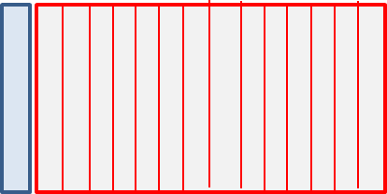
Step 2: Descriptor with the greatest standard deviation in its coefficient is chosen (the one changed previously is not considered) and substituted with all the remaining D - d descriptors, one by one.
(D-d+1)
dki
Repeat for each of dk descriptors
dk
Coefficient For
First descriptor
Calculate standard deviation of
selected descriptors
this procedure repeat until the set remains unmodified.
we obtain the candidate $d_{m}^{(i)}$ that came from the so-constructed path i.
It is worth noting that if the replacement of the descriptor with the largest error by those in the pool does not decrease the value of S, then we do not change that descriptor.

Slide 7
Example:
10
1
5
6
2
3
8
4
7
9
10
5
1
2
3
4
5
6
7
8
9
10
1
2
3
S1
S4
8
4
2
3
S1
S4
S5
S6
S7
S8
S9
S10
5
2
3
S5
1
Smin
S6
6
2
3
S6
.
.
.
6
2
3
10
2
3
S10

Slide 8
8
6
2
3
4
5
1
7
8
9
10
3
8
S2
S4
S5
S1
S7
S8
S9
S10
6
2
3
S2
1
Smin
S9
6
4
3
S4
6
5
3
S5
6
9
3
6
1
3
S1
.
.
.
If S2 be min
No replace
If S9 be min
Replace with
discriptor2
6
10
3
S10

Slide 9
6
9
3
4
5
1
7
8
2
10
8
6
9
3
S3
S3
S4
S5
S1
S7
S8
S2
S10
6
9
4
S4
1
Smin
S5
6
9
5
S5
6
9
1
S1
6
9
5
.
.
.
S10
6
9
10
6
9
5

Slide 10
6
9
5
4
3
1
7
8
2
10
.
.
.
6
7
5
4
3
1
9
8
2
10
.
.
.
6
7
5
Give the optimal set after two cycle

Slide 11
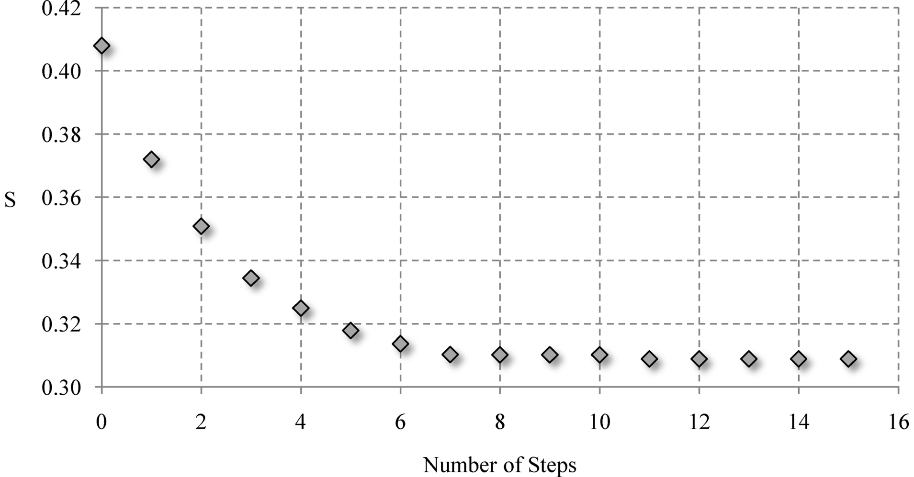
Step 3: The above process is carried out for all the possible paths i = 1, 2, ..., d, and the point dm with the smallest standard deviation: mini $S\left(d_{m}^{\left(i\right)}\right)$ is kept.
Standard deviation vs number of steps for the RM

Slide 12
Enhanced Replacement Method ERM:
The ERM is a three step combination of two algorithms:
first the RM already described above, then a modified RM (MRM), and finally a RM is used again.
MRM follows the same strategy as RM except that in each step the descriptor with the largest error is substituted even if that substitution is not accompanied by a smaller value of S (the next smallest value of S is chosen).
The main difference in MRM is that it adds some sort of noise that prevents the selected model to stay in a local minimum of S.

Slide 13
6
2
3
4
5
1
7
8
9
10
8
6
2
3
S2
S2
S4
S5
S1
S7
S8
S9
S10
6
4
3
S4
1
Smin
S9
6
5
3
S5
6
1
3
S1
6
9
3
.
.
.
S10
If S2 be min
No replace
6
10
3
If S9 be min
Replace with
discriptor2

Slide 14
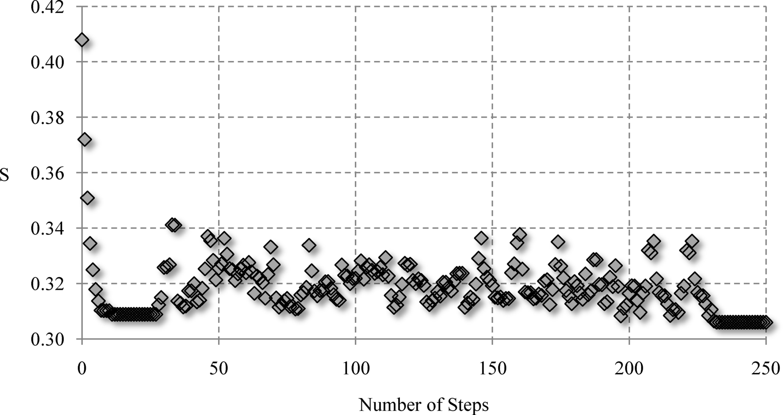
Standard deviation vs number of steps for the ERM

Slide 15
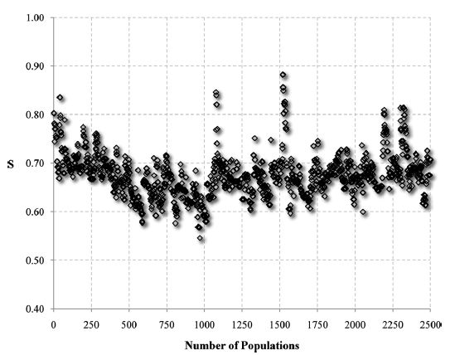
Result of GA with different number of individuals
Standard deviation vs population number for GA with number of individuals = 5, generation gap = 0.9, single-point crossover probability = 0.6, and
mutation probability = 0.7/d.

Slide 16
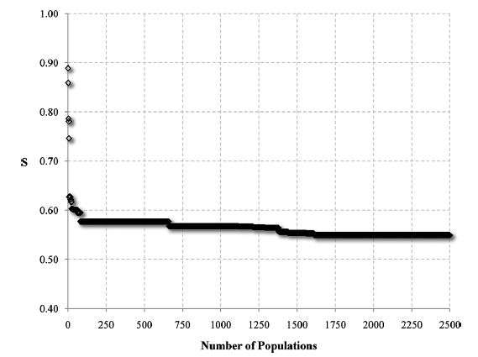
Standard deviation vs population number for GA with number of individuals = 20, generation gap = 0.9, single-point crossover probability = 0.6, and
mutation probability = 0.7/d.

Slide 17
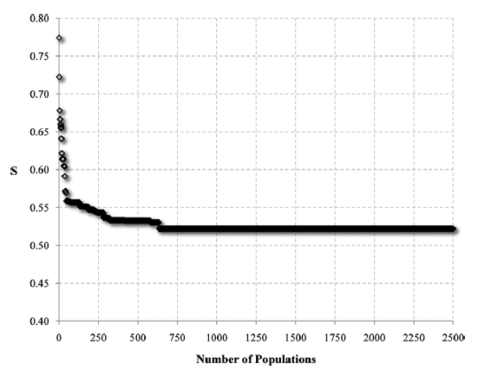
Standard deviation vs population number for GA with number of individuals = 100, generation gap = 0.9, single-point crossover probability = 0.6, and
mutation probability = 0.7/d.

Slide 18
A full search for GABA data
$$\frac{D!}{d!(D−d)!}$$

Slide 19
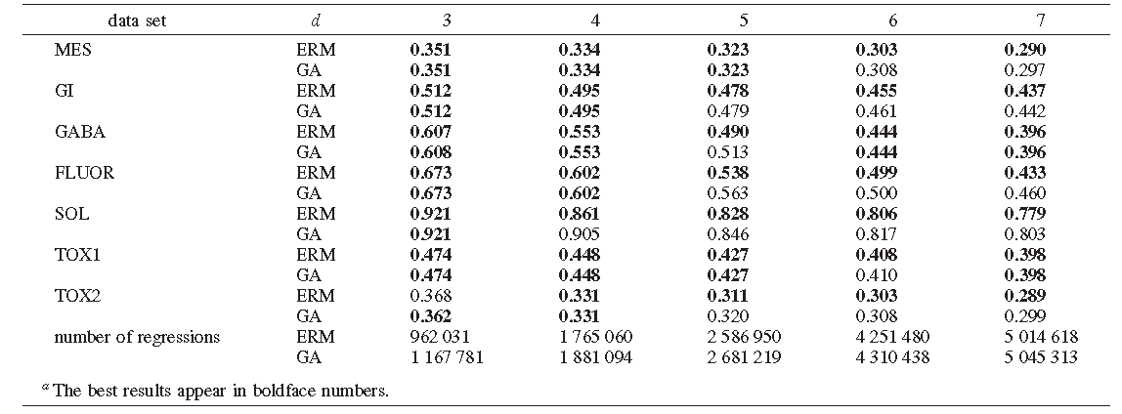
It should to be kept in mind that since the GA is a nondeterministic methodology, then its results may change for different runs using exactly the same
initial conditions.

Slide 20
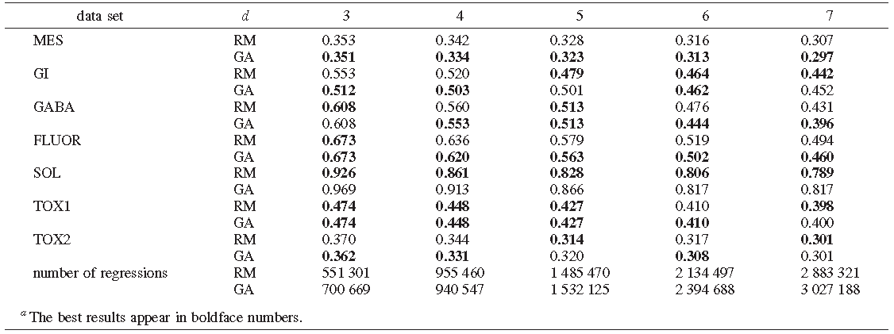
Table 3 also suggests that the GA is better than the RM in 51.4% of the cases, the latter approach is preferable in 31.4% of the cases and both methods produce similar results in 17.1% of the cases. However, it should be kept in mind that the RM is a much simpler algorithm. It is also clear that the ERM is preferable to the RM.

Slide 21
Table 4 shows that both the RM and ERM lead to models with values of S that are smaller or similar to those of GA.

Slide 22
CONCLUSIONS:
The results suggested that ERM was preferable to GA.
To the quality of the results, we should add the fact that the ERM is much simpler than the GA.
We have also shown that although the GA is slightly better than the RM, simplicity and lower computational cost make the latter more attractive.
Finally, it is worth mentioning the three methods RM, ERM, and GA can be used under different conditions as alternative strategies for the construction of models for chemical properties and activities from quite large pools of descriptors for molecular structure.

Slide 23
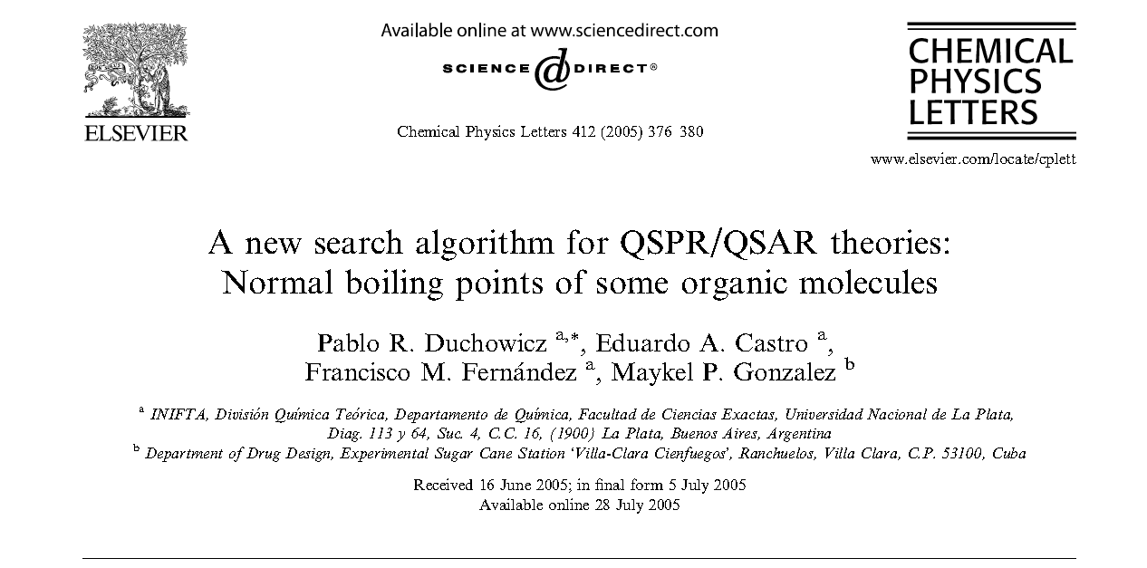
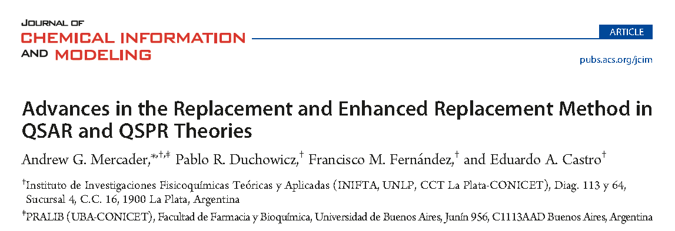

Slide 24
Thanks

