Slide 1
Graph Representation Learning
Zahra Narimani
IT & CS department, IASBS, Zanjan

Slide 2
Outline
What is machine learning?
Data
Graph representation
Classic methods
Learning-based methods
Shallow
Deep
Summary
Main reference: Hamilton WL. Graph representation learning. Morgan & Claypool Publishers; 2020 Sep 16.

Slide 3
What is machine learning?
"Machine learning is the study of computer algorithms that improve automatically through experience and by the use of data. It is seen as a subset of artificial intelligence."
- Shalev-Shwartz, S., & Ben-David, S. (2014). Understanding Machine Learning: From Theory to Algorithms. Cambridge University Press.

Slide 4
Robot motion planning

Slide 5
Classification
Training Data with class label:
Model
Learning
Training
Instances
Positive
Prediction
Model
Test
Instances
Negative

Slide 6
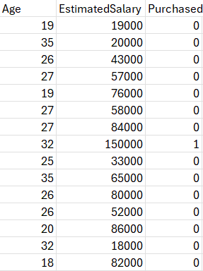
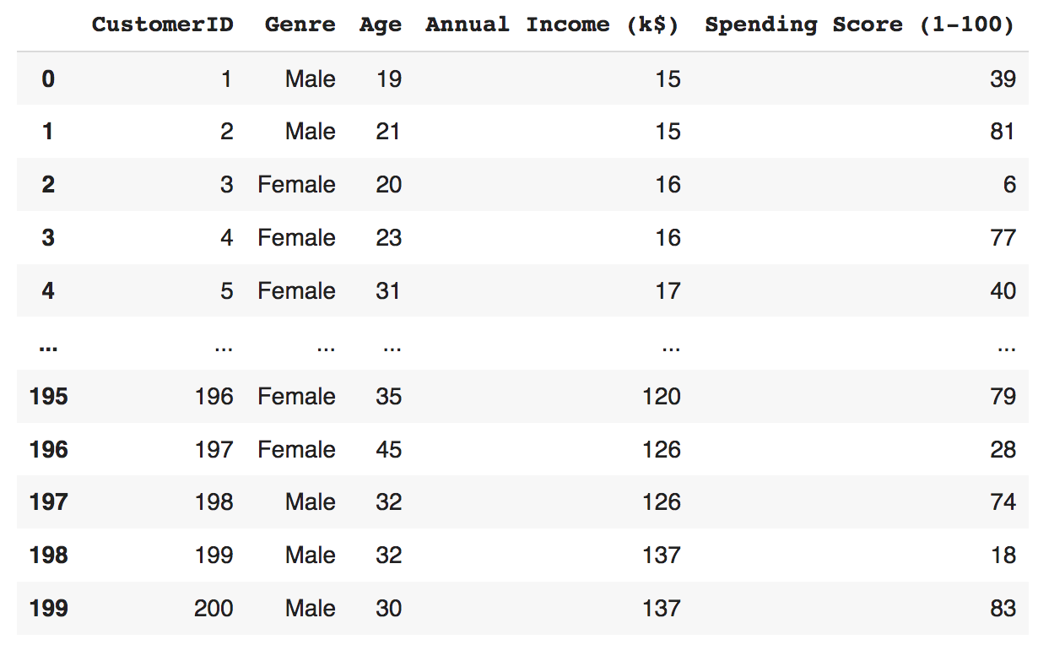
What is data?
attributes
samples

Slide 7
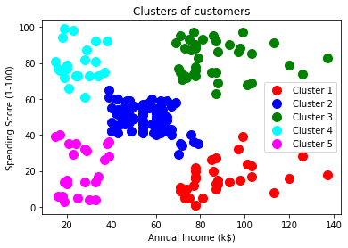
Similarity and patterns

Slide 8
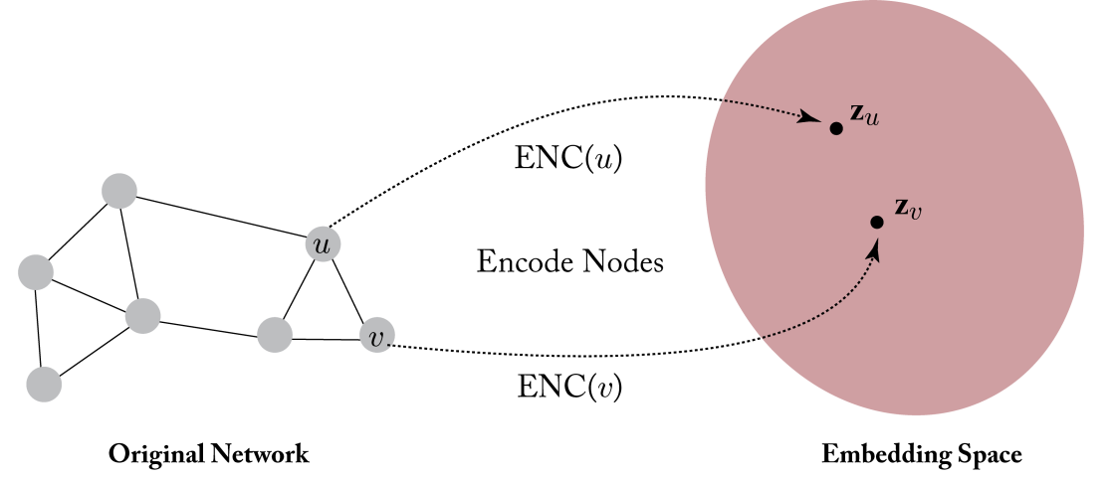
Problem definition
Input to ML methods is numerical vector
Represent the data in a space in which similarity between datapoints are conserved
Our data is (attributed) graphs

Slide 9
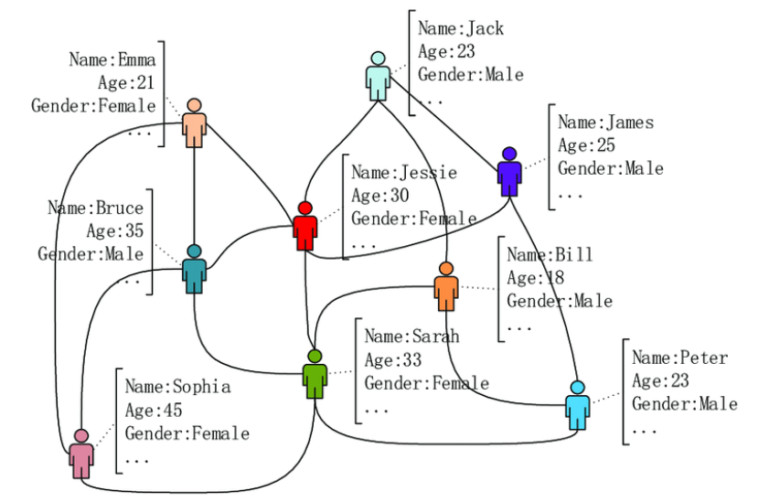
Graph data – recommender system

Slide 10
Protein-protein networks

Slide 11
What is a graph?
Formally, a graph G=(V,E) is defined by a set of nodes V and a set of edges E between these nodes.
Simple graph
Directed graph
Adjacency matrix A ($A\left[u,v\right]=1 if \left(u,v\right)∈E, andA\left[u,v\right]=0 otherwise$)
Notes:
simple graphs, where there is at most one edge between each pair of nodes, no edges between a node and itself, and where the edges are all undirected, i.e., .u; v/ 2 E $ .v; u/ 2 E

Slide 12
Graph representation
Adjacency matrix?
Can it serve as a proper input to machine learning algorithms?

Slide 13
Example – is Node1 more similar to Node5 or Node900?
5
>1000 nodes
1
2
8
4
901
3
6
9
900
7
905

Slide 14
Adjacency-based representation
>1000 nodes
5
1
2
8
4
901
3
9
900
6
7
905

Slide 15
Graph Statistics and kernel methods
Extract some statistics or features based on heuristic functions or domain knowledge
Use these features as (graph-related) input to ML algorithms
Node level features
Graph level features and kernel methods

Slide 16
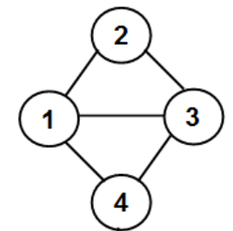
Node centrality measures
Degree centrality
Eigenvector centrality
Clustering coefficient
Measures counting motifs around a node

Slide 17
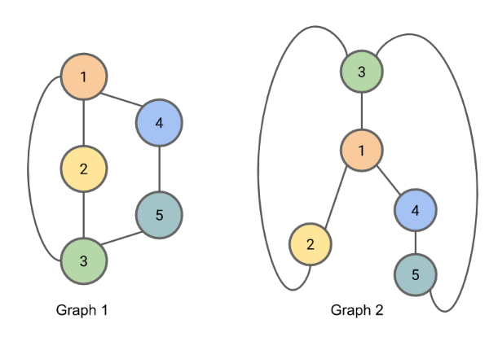
Graph-level features
Bag of nodes (histogram or other summaries on node-level features)
Weisfieler–Lehman Kernel
WL-1 test for detecting isomorphism in graphs

Slide 18
Graph-level features
Bag of nodes (histogram or other summaries on node-level features)
Weisfieler–Lehman Kernel
Iterative neighborhood aggregation
Assign an initial label $l^{\left(0\right)}(v)$ to each node ($l^{\left(0\right)}\left(v\right)=d_{v}$)
Assign a new label to each node by hashing the multi-set of the current labels within the node’s neighborhood
After k iterations label $l^{\left(k\right)}(v)$ is the K-hop representation of Graph

Slide 19
Neighborhood overlap detection
Previous methods does not reflect node relationships – link prediction
Jaccard overlap

Slide 20
What is learning?
Let the data talks!
Instead of using features like centrality measures, BMI (medicine), SIFT (image processing), extract features from data itself.

Slide 21
Node embedding
Learn an encoder (enc), which maps nodes to a low-dimensional embedding space
Distances in the embedding space reflect the relative positions of the nodes in the original graph

Slide 22
Encoder-decoder approach
Decoder will reconstruct the local neighborhood of u

Slide 23
Decoder
Reconstruct certain graph statistics from the node embeddings that are generated by the encoder
Pairwise decoders:
Minimize a reconstruction loss so that:
S[u,v] is a graph-based similarity measure between nodes (inner product, Euclidean distance)
Notes:
Common decoders -> pairwise decoders; predict if the two nodes have relationship in the original graph or not

Slide 24
Shallow embedding approaches
Random walk embeddings
Deepwalk
Node2Vec
Graph factorization based
Notes:
The key benefit of the encoder-decoder framework is that it allows one to succinctly define and compare different embedding methods based on (i) their decoder function, (ii) their graph-based similarity measure, and (iii) their loss function.

Slide 25
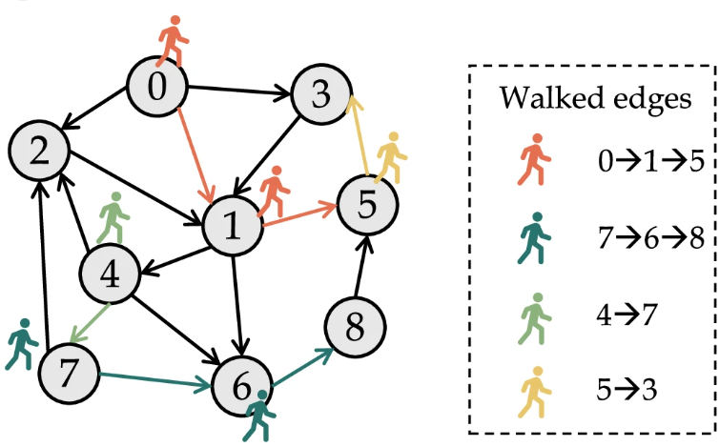
Random walk based methods
Two nodes have similar embeddings if they tend to cooccur on short random walks over the graph
Notes:
Node embeddings are optimized so that two nodes have similar embeddings if they tend to cooccur on short random walks over the graph

Slide 26
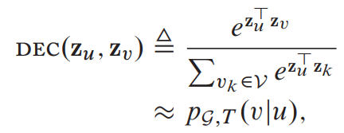
Random walk based methods
Two nodes have similar embeddings if they tend to cooccur on short random walks over the graph
p_{G;T} (v|u) is the probability of visiting v on a length-T random walk starting at u, with T usually defined to be in the range {2,…,10}
Notes:
Node embeddings are optimized so that two nodes have similar embeddings if they tend to cooccur on short random walks over the graph

Slide 27
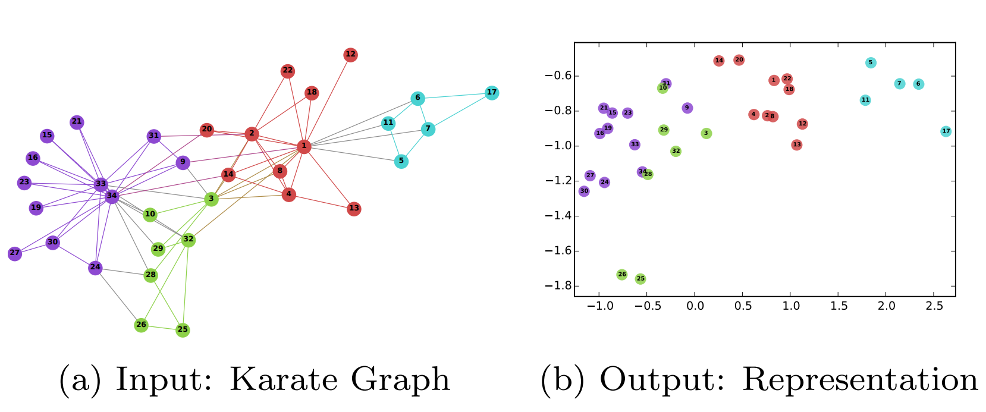
Deepwalk
Perozzi B, Al-Rfou R, Skiena S. Deepwalk: Online learning of social representations. InProceedings of the 20th ACM SIGKDD international conference on Knowledge discovery and data mining 2014 Aug 24 (pp. 701-710).

Slide 28
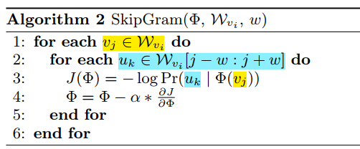
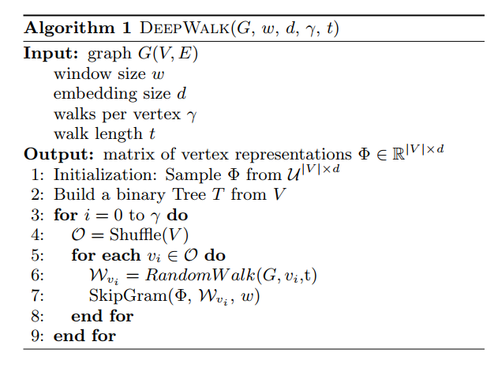
SkipGram is a language model that maximizes the cooccurrence probability among the words that appear within a window, w, in a sentence.

Slide 29
Node2Vec
Inspired from word2wec language model

Slide 30
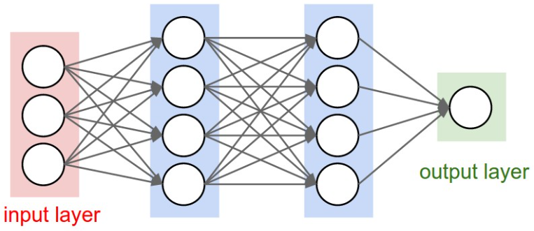
Neural network structure

Slide 31
ساختار یادگیری عمیق
x
وزن ها
لایه پنهان اول
هدف: پیدا کردن این وزن ها
وزن ها
لایه پنهان دوم
پیش بینی ها (y’)
اهداف حقیقی (y)

Slide 32
ساختار یادگیری عمیق
x
وزن ها
لایه (تبدیل داده ها)
هدف: پیدا کردن این وزن ها
وزن ها
لایه (تبدیل داده ها)
پیش بینی ها (y’)
اهداف حقیقی (y)
تابع هزینه
خطا

Slide 33
ساختار یادگیری عمیق
x
وزن ها
لایه (تبدیل داده ها)
هدف: پیدا کردن این وزن ها
وزن ها
لایه (تبدیل داده ها)
پیش بینی ها (y’)
اهداف حقیقی (y)
بهینه ساز
تابع هزینه
خطا

Slide 34
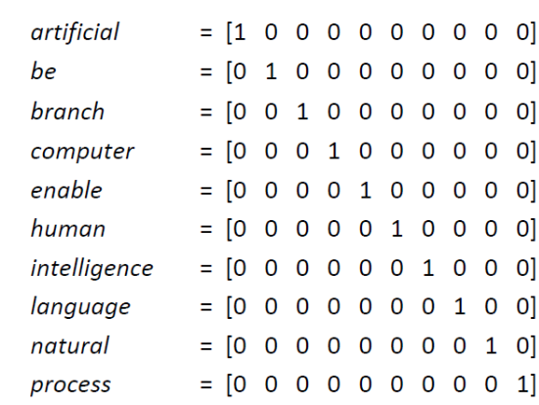
Word2Vec language model
One-hot encoding of words
Mikolov T. Efficient estimation of word representations in vector space. arXiv preprint arXiv:1301.3781. 2013;3781.

Slide 35
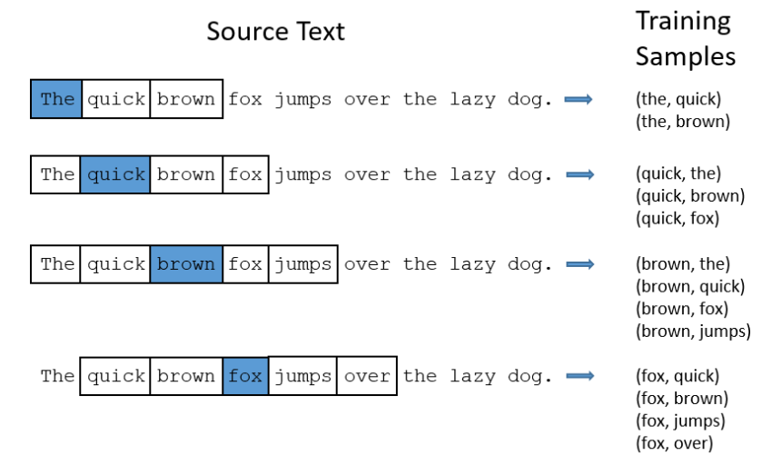
Skipgram – the fake task
Given a specific word in the middle of a sentence (the input word), look at the words nearby and pick one at random.
The network is probably going to get many more training samples of (“Soviet”, “Union”) than it is of (“Soviet”, “Sasquatch”)

Slide 36
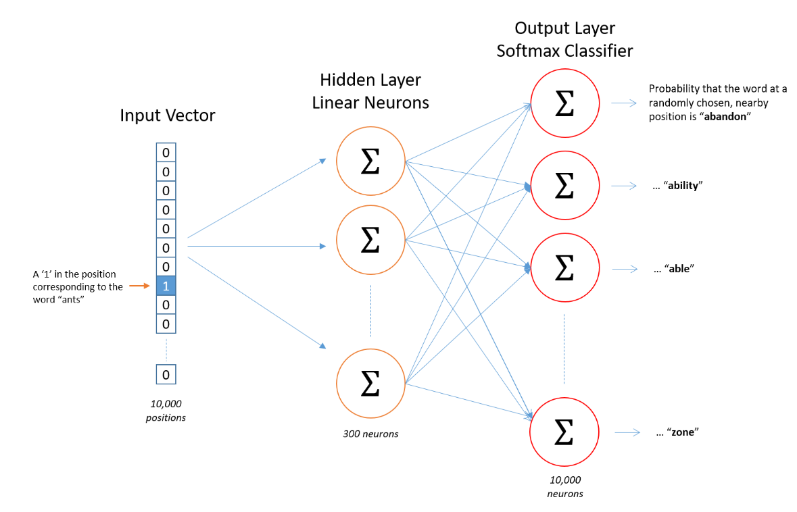

Slide 37
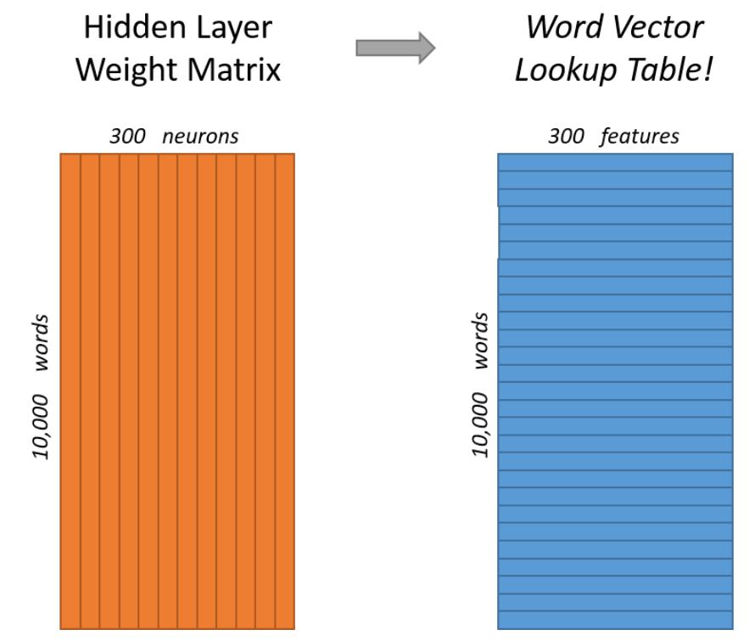
word2vec word embedding

Slide 38
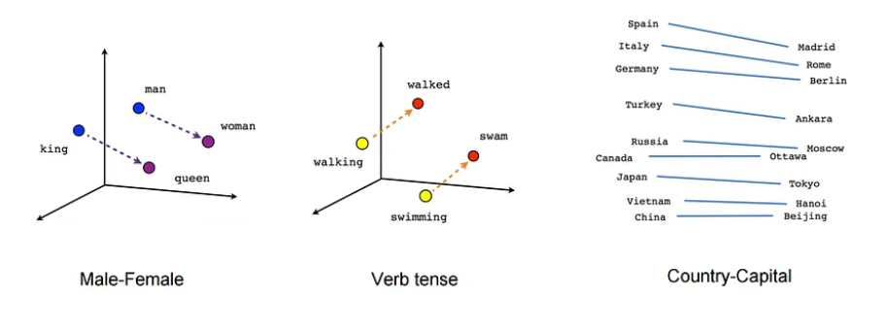
Word2vec output example

Slide 39
Node2vec
Grover A, Leskovec J. node2vec: Scalable feature learning for networks. InProceedings of the 22nd ACM SIGKDD international conference on Knowledge discovery and data mining 2016 Aug 13 (pp. 855-864).

Slide 40
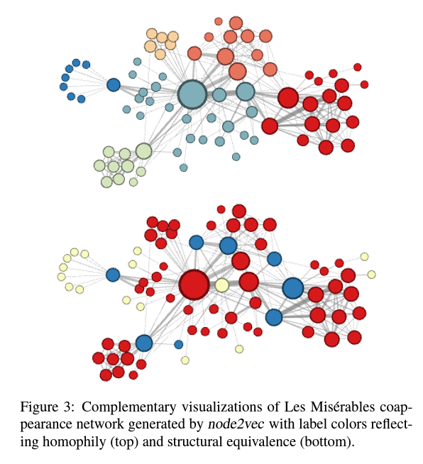
Grover A, Leskovec J. node2vec: Scalable feature learning for networks. InProceedings of the 22nd ACM SIGKDD international conference on Knowledge discovery and data mining 2016 Aug 13 (pp. 855-864).

Slide 41
Deep embedding approaches
GNN
GIN
Anchor-aware representation

Slide 42
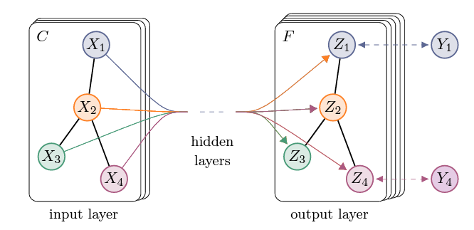
Graph Neural Networks
Idea: feed the adjacency matrix to a MLP
Issue: depend on the ordering of the nodes
The representation should be permutation invariance and equivariance:
Notes:
Te issue with this approach is that it depends on the arbitrary ordering of nodes that we used in the adjacency matrix. In other words, such a model is not permutation invariant, and a key desideratum for designing neural networks over graphs is that they should permutation invariant (or equivariant). In mathematical terms, any function f that takes an adjacency matrix A as input should ideally satisfy one of the two following properties:
Permutation invariance means that the function does not depend on the arbitrary ordering of the rows/columns in the adjacency matrix, while permutation equivariance means that the output of f is permuted in an consistent way when we permute the adjacency matrix. (Te shallow encoders we discussed in Part I are an example of permutation equivariant functions.) Ensuring invariance or equivariance is a key challenge when we are learning over graphs, and we will revisit issues surrounding permutation equivariance and invariance often in the ensuing chapters.

Slide 43
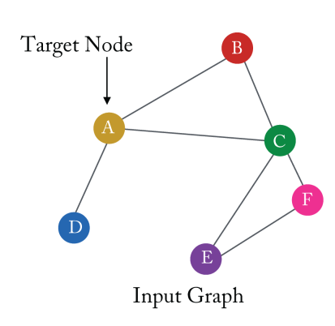
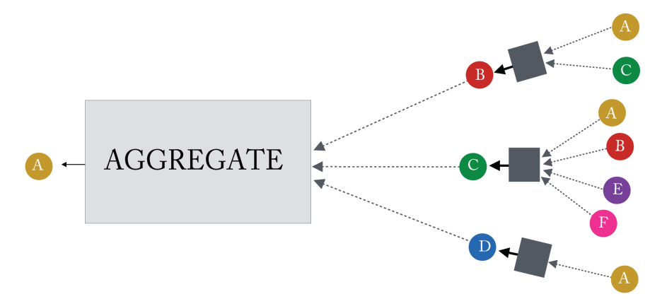
Neural message passing

Slide 44
Aggregation functions
Mean aggregation
Max aggregation
Concatenation + linear mapping + non-linearity

Slide 45
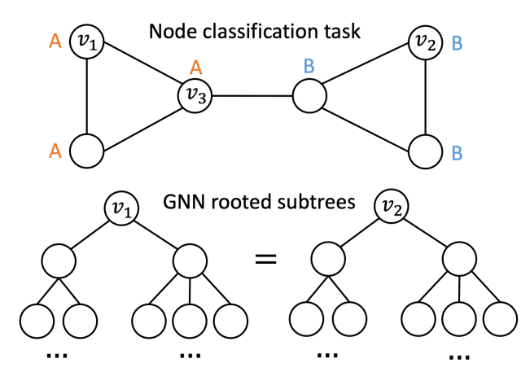
Position-awareness
Example graph where GNN is not able to distinguish and thus classify nodes v₁ and v₂ into different classes based on the network structure alone.
You J, Ying R, Leskovec J. Position-aware graph neural networks. InInternational conference on machine learning 2019 May 24 (pp. 7134-7143). PMLR.

Slide 46
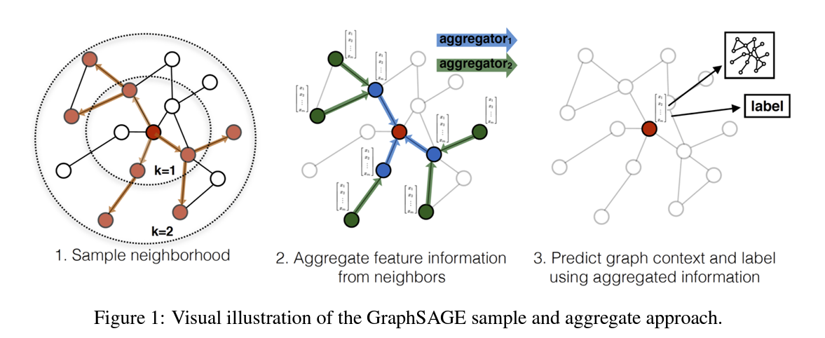
Sample based aggregation
Hamilton W, Ying Z, Leskovec J. Inductive representation learning on large graphs. Advances in neural information processing systems. 2017;30.

Slide 47
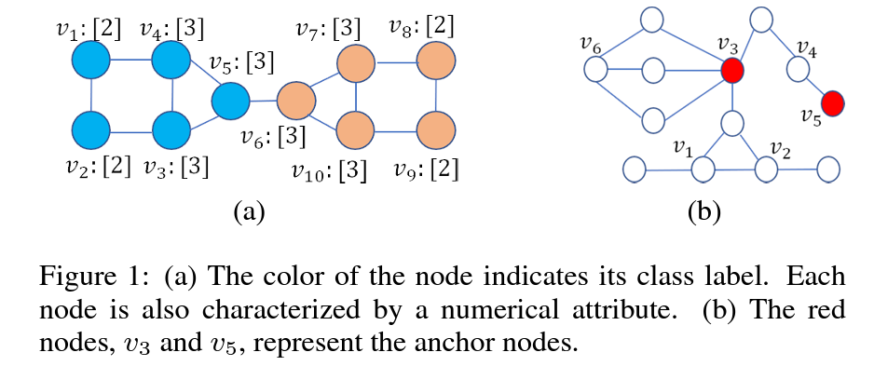
Anchor selection
Nishad S, Agarwal S, Bhattacharya A, Ranu S. Graphreach: Position-aware graph neural network using reachability estimations. arXiv preprint arXiv:2008.09657. 2020 Aug 19.

Slide 48
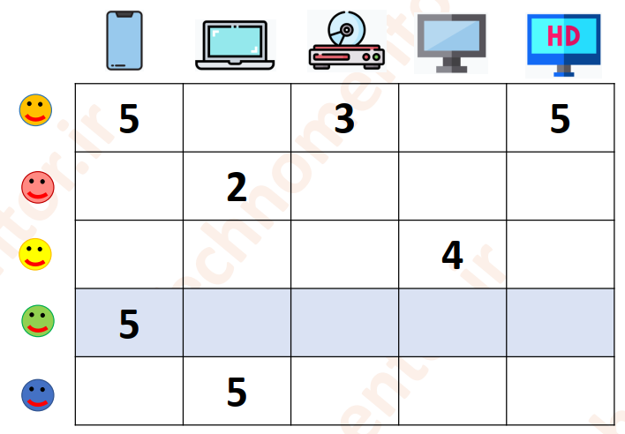
One of our current projects
Recommender systems
Clustering-based recommendations
Sparse data
Latent features such as SVD
GNN-based representations
Anchor-awareness

Slide 49
ML on graphs Node classification
Predict the label y_{u} associated with all the nodes $u∈V$, when we are only given the true labels on a training set of nodes $V_{train}⊂V$
Classifying the function of proteins in the interactome
Classifying the topic of documents based on hyperlink or citation graphs
Notes:
Different names; depending on the specific application domain

Slide 50
ML on graphs Relation prediction
Given a set of nodes V and an incomplete set of edges between these nodes $E_{train}⊂E,$ Our goal is to use this partial information to infer the missing edges ${E\backslash E}_{train}$.
Link prediction, graph completion, and relational inference
Recommending content to users in social platforms
Predicting drug side-effects
Inferring new facts in a relational databases
Notes:
label y_{u}— which could be a type, category, or attribute—associated

Slide 51
ML on graphs Clustering and community detection
Given a set of nodes V and an incomplete set of edges between these nodes $E_{train}⊂E,$ Our goal is to use this partial information to infer the missing edges ${E\backslash E}_{train}$.
Link prediction, graph completion, and relational inference
Recommending content to users in social platforms
Predicting drug side-effects
Inferring new facts in a relational databases
Notes:
label y_{u}— which could be a type, category, or attribute—associated

Slide 52
Challenges in GNNs
Over smoothing
As the number of layers increases, the deep GNN models lose the node’s local information
Non-optimal topology
Neighbor awareness, Anchor selection
Different types of graphs
Over squashing
When messages are aggregated over a lengthy path, leading to a bottleneck effect where the volume of data is compressed into fixed-size vectors
Scalability
…

Slide 53
Summary
Graphs in machine learning
Traditional representations
Learning-based representations
GNNs
A possibility to collaborate

Slide 54
Thanks for your attention ☺

